Slide 1

Containers Everywhere!
Sebastián Gómez
@sebagomez
Sr. Software Engineer

Slide 3

COME TO THE DARK SIDE
WE HAVE CONTAINERS

Slide 4
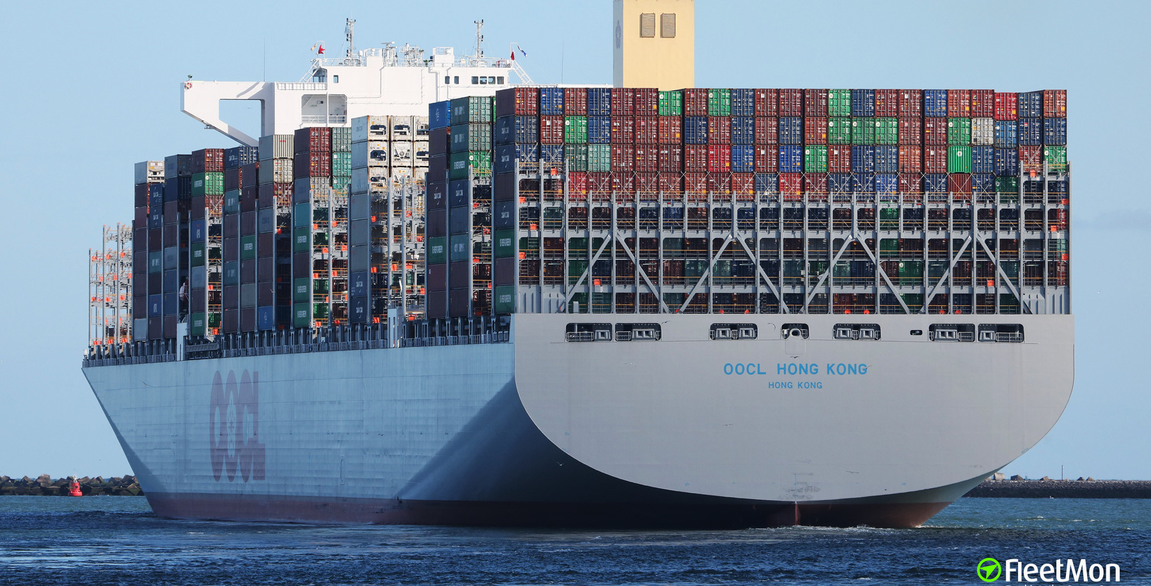

Slide 5

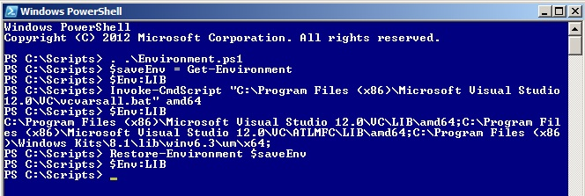
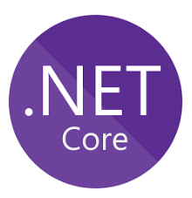

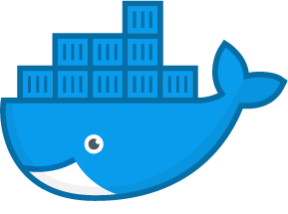
What’s in a container?

Slide 6
VMs vs Containers
App1
App2
App3
bin/libs
bin/libs
bin/libs
App1
App2
App3
Guest OS
Guest OS
Guest OS
bin/libs
bin/libs
bin/libs
Hypervisor
Docker
Hosting Operating System
Hosting Operating System

Slide 7

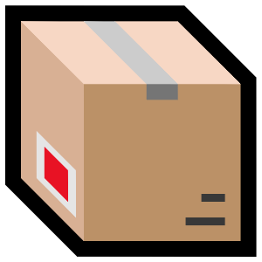
build
run
dockerfile
image
container

Slide 8
FROM microsoft/dotnet:2.1.6-aspnetcore-runtime
LABEL maintainer="seba gomez <sebagomezcorrea@outlook.com>"
ARG BUILD
ENV APPVERSION=$BUILD
WORKDIR /app
COPY ["root", "/app"]
ENTRYPOINT ["dotnet", "AngularWebStorageExplorer.dll"]

Slide 9
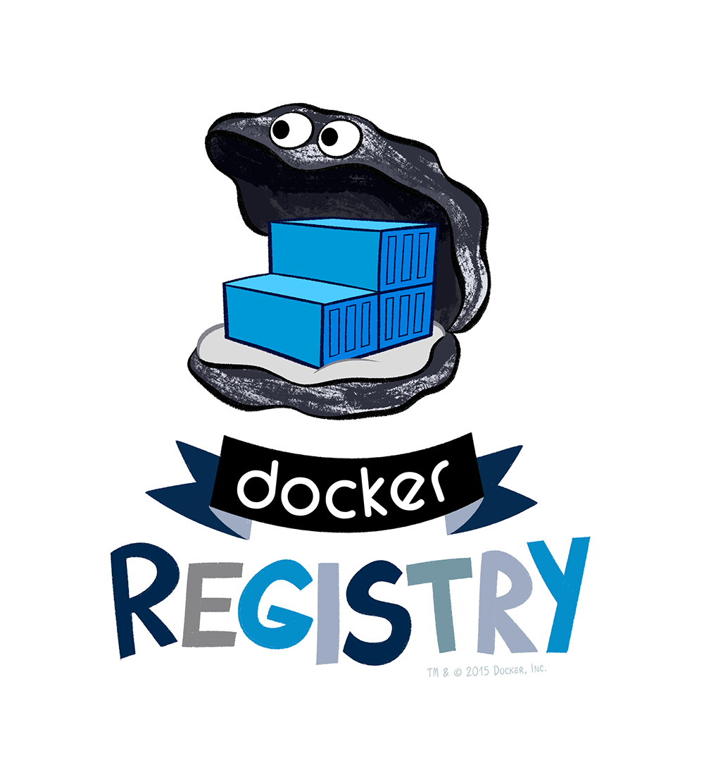
push
image

Slide 10
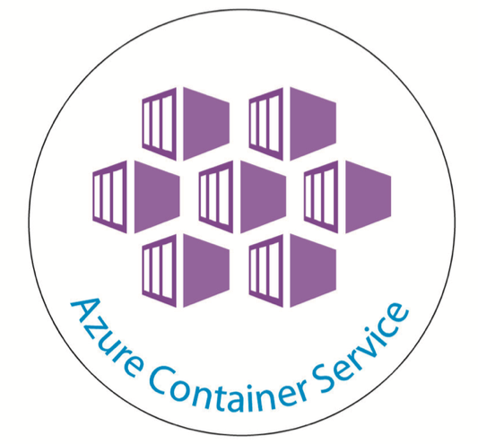


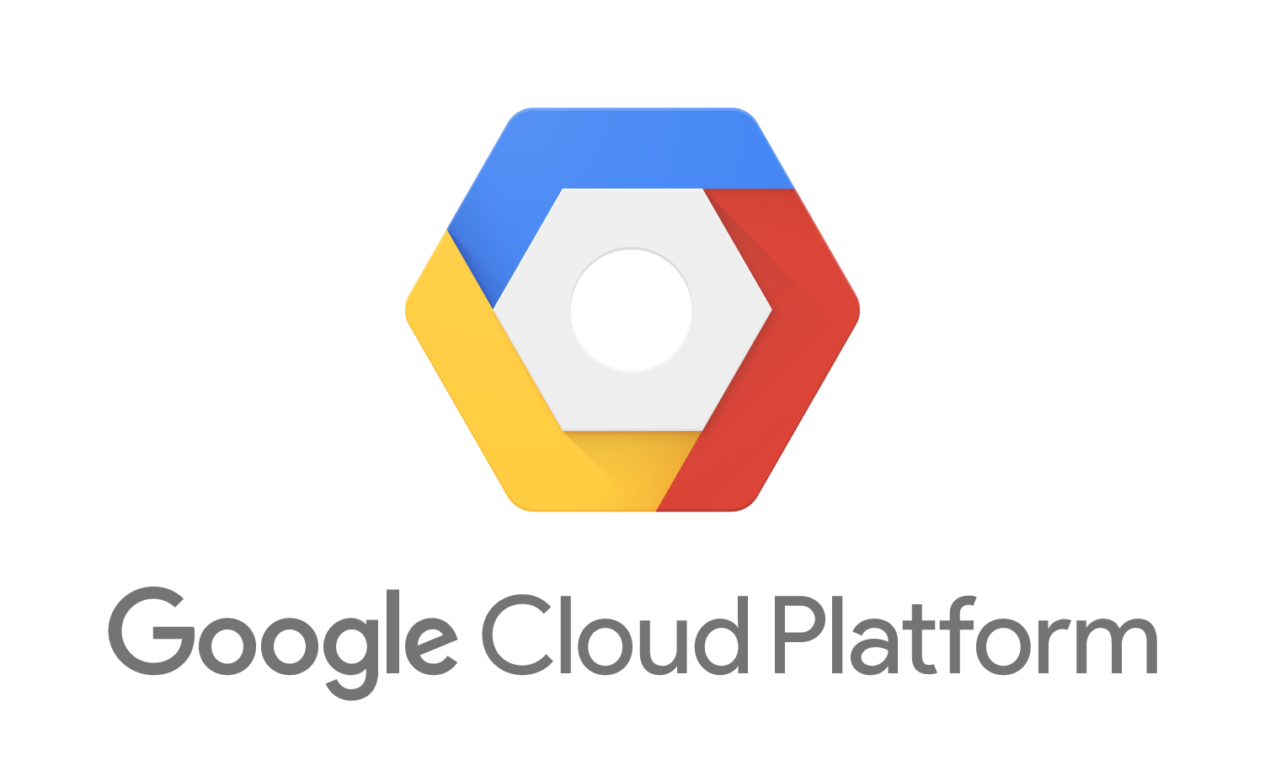
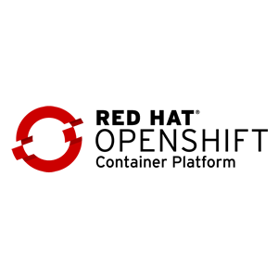

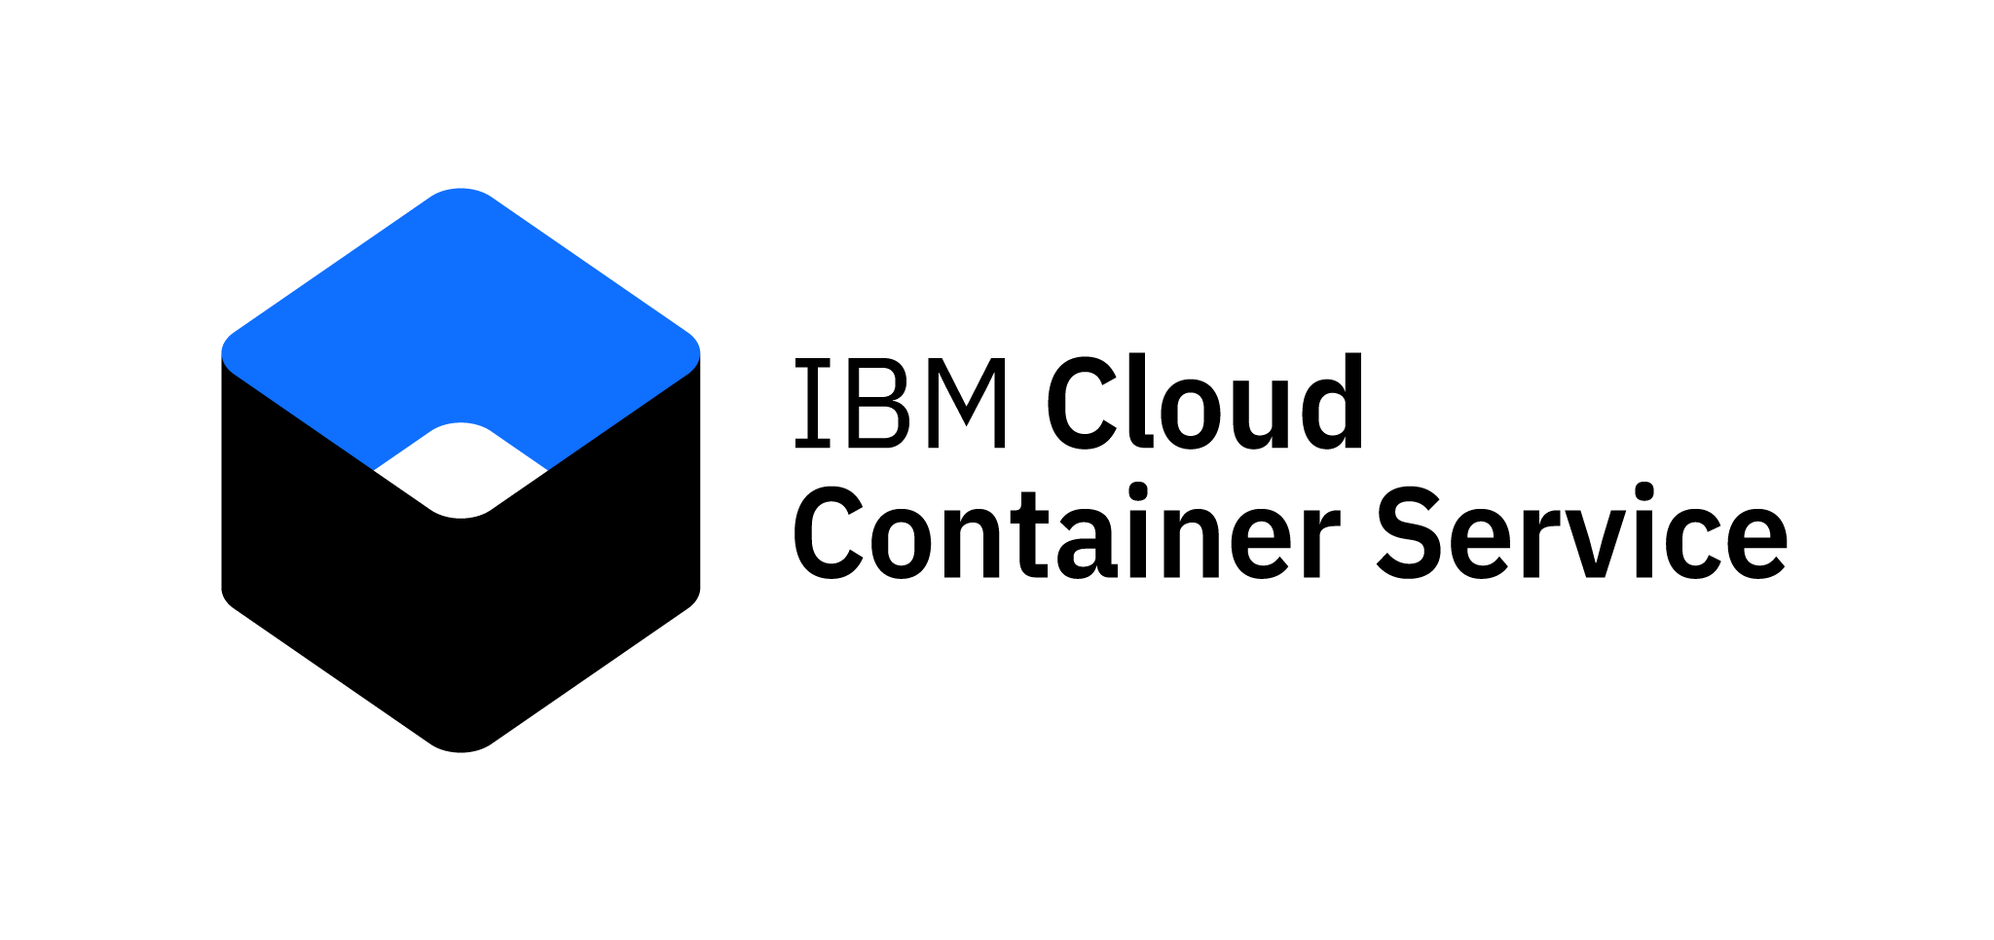
pull

Slide 11

Demo
Notes:
Spin up TOR, Chromium, SQL Server, SQL Server 2019, and W95

Slide 12
DBs: SQL Server 2019 / MySQL / PostgreSQL / Oracle
AppServers: Tomcat / WebSphere / JBoss / NginX
IDEs: Eclipse / VSCode / Electron
Runtimes: Ruby / Python / NodeJS / .NET Core
Tools: Azure CLI / Azure Storage Explorer
Web Applications: (all of them)
OS: Ubuntu / SuSE / Debian / Windows 95!
Great for Legacy!
Notes:
Spin up TOR, Chromium, SQL Server, SQL Server 2019, and W95

Slide 13

Useful links
www.docker.com (Docker for Windows/Mac)
docs.docker.com (Dockerfile & CLI Reference)
training.play-with-docker.com
hub.docker.com
github.com/sebagomez/containerseverywhere

Slide 14
COME TO THE DARK SIDE
WE HAVE CONTAINERS

Slide 15
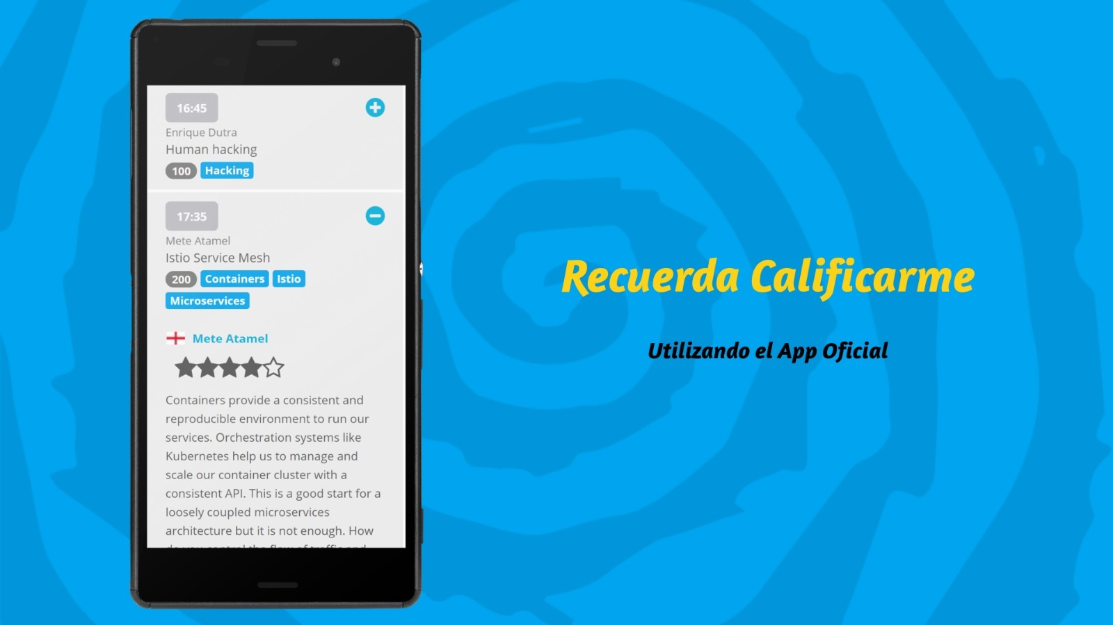


Slide 16
Thank you!
Sebastián Gómez
sgomez@genexus.com
@sebagomez
github.com/sebagomez/containerseverywhere

